Slide 1
SMS-SIR-EPI Manual
Yi-Cheng, Hsu

Slide 2
Image acquisition parameters.

Slide 3
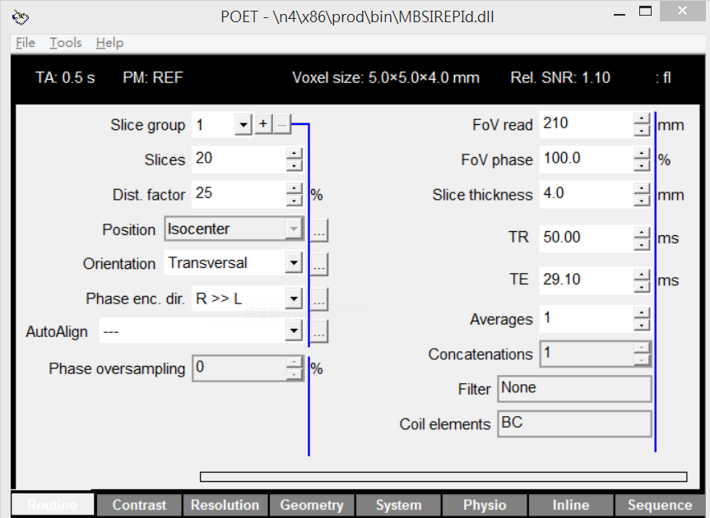
FOV = 210 and 330 is suggested for 2 Segments and 1 Segment image acquisition respectively.
Multiple of 4 is supported in my Matlab image reconstruction function.
TR = 50 and TR = 100 is suggested for 2 Segments and 1 Segment image acquisition respectively.
A-P phase encoding direction produces more symmetric distortion.
R-L phase encoding direction results in lower noise amplification.

Slide 4
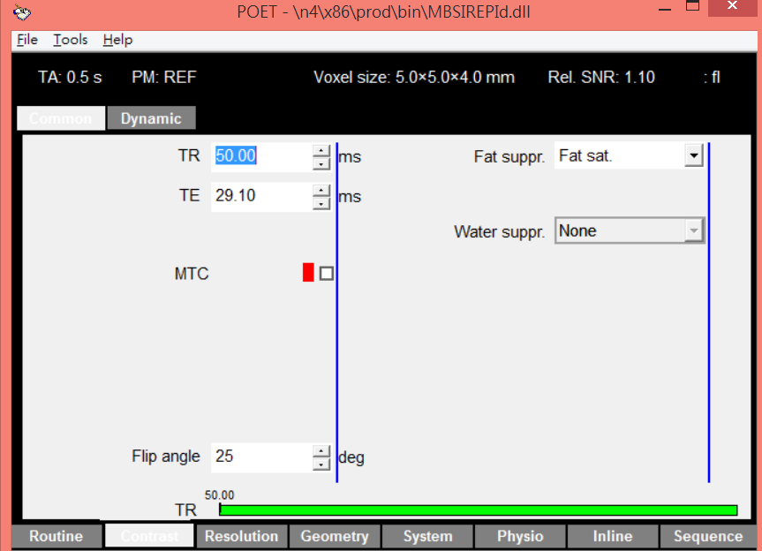
Fat suppression is required in VD, don’t use this in VB because it’s already hard-coded.
FA = 30 and FA = 25 is suggested for 2 Segments and 1 Segment image acquisition respectively.

Slide 5
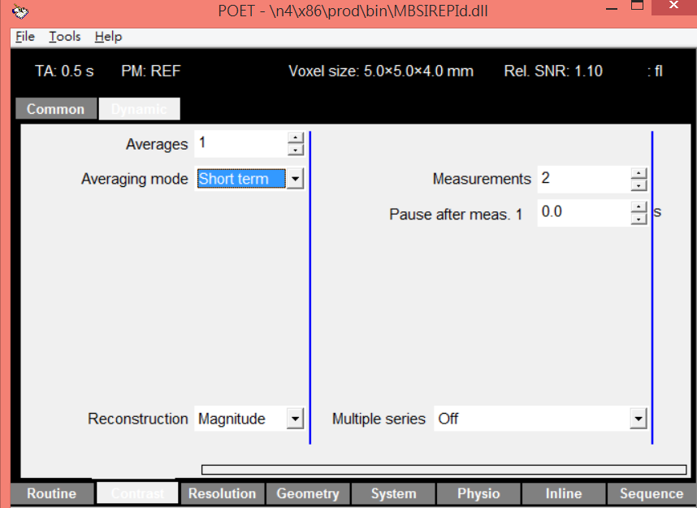
10 measurements is needed for the reference scan.
The first measurement is only for calibration.

Slide 6
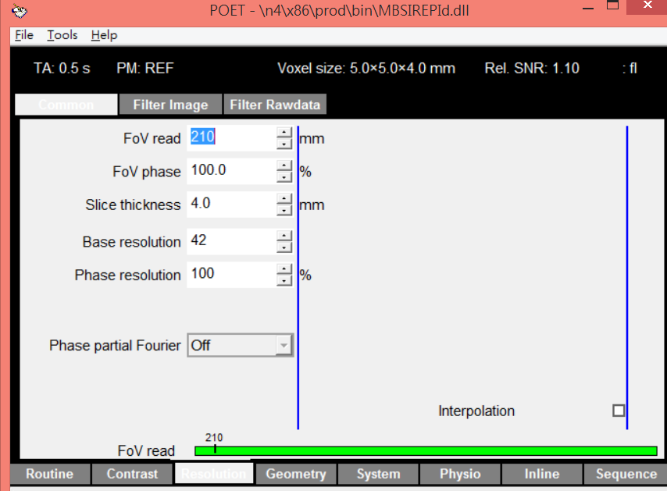
Resolution = 42 and 66 is suggested for 2 Segments and 1 Segment image acquisition respectively.

Slide 7
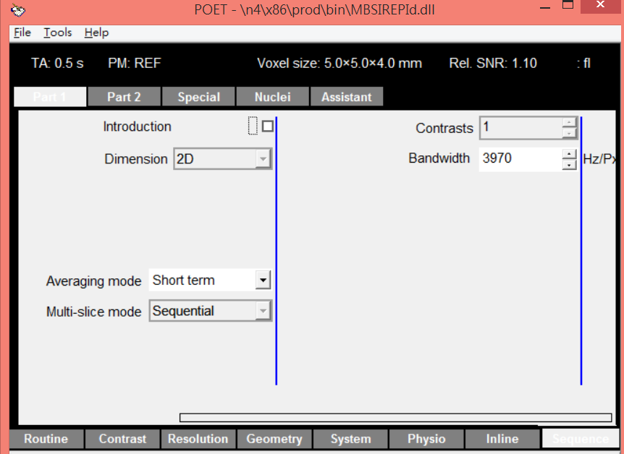
More than 3970 Hz/Px is suggested to reduce distorsion.

Slide 8
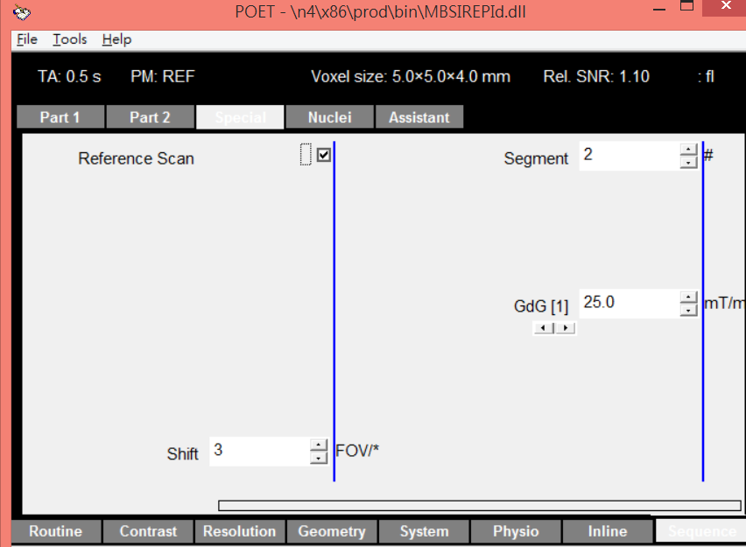
Set check box on, when reference scan is performed to acquired in-vivo coil sensitivities.
This parameter determines how many SMS-SIR-EPI acquisitions were performed to acquire one measurement of whole brain image.
Compared with 1 segment, 2 Segments is suggested to acquire less distorted and higher SNR images within less than 100 ms.
This parameter determines how many FOV/Shift shift between adjacent simultaneously excited slices. 3 is suggested.

Slide 9
Image reconstruction examples.

Slide 10
For 2 segments image acquisition, the parameters of reference scan can be found in “MBSIREPI_20160222_seg2_ref.pdf” and the parameters of accelerated scan can be found in “MBSIREPI_20160222_seg2_acc.pdf”. To reconstruct reference image (Image_ref) and accelerated scan (Image_acc), use the following command in Matlab :
[Image_ref, Image_acc] = MBrecon( 'meas_MID00364_FID98279_MBSIREPI_20160218_ref.dat','meas_MID00365_FID98280_MBSIREPI_20160218_acc.dat',0.005 );
.dat files are raw data of reference scan and accelerated scan respectively and 0.005 is regularization parameter which can be adjusted according to acceleration factor and SNR.
Similarly, for 1 segments image acquisition, the parameters of reference scan can be found in “MBSIREPI_20160222_seg1_ref.pdf” and the parameters of accelerated scan can be found in “MBSIREPI_20160222_seg1_acc.pdf”. To reconstruct reference image (Image_ref) and accelerated scan (Image_acc), use the following command in Matlab :
[Image_ref, Image_acc] = Mbrecon_ini( 'meas_MID00364_FID98279_MBSIREPI_20160218_ref.dat','meas_MID00365_FID98280_MBSIREPI_20160218_acc.dat',0.005 );

